Slide 1

Choosing a technical career

Slide 2
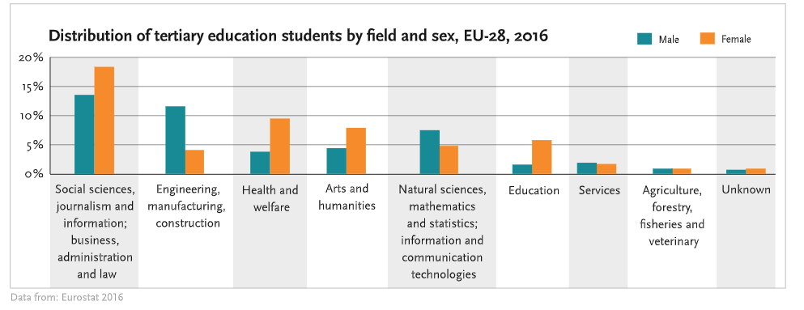
Popular STEM careers
Social science
Engineering
Health and welfare

Slide 3
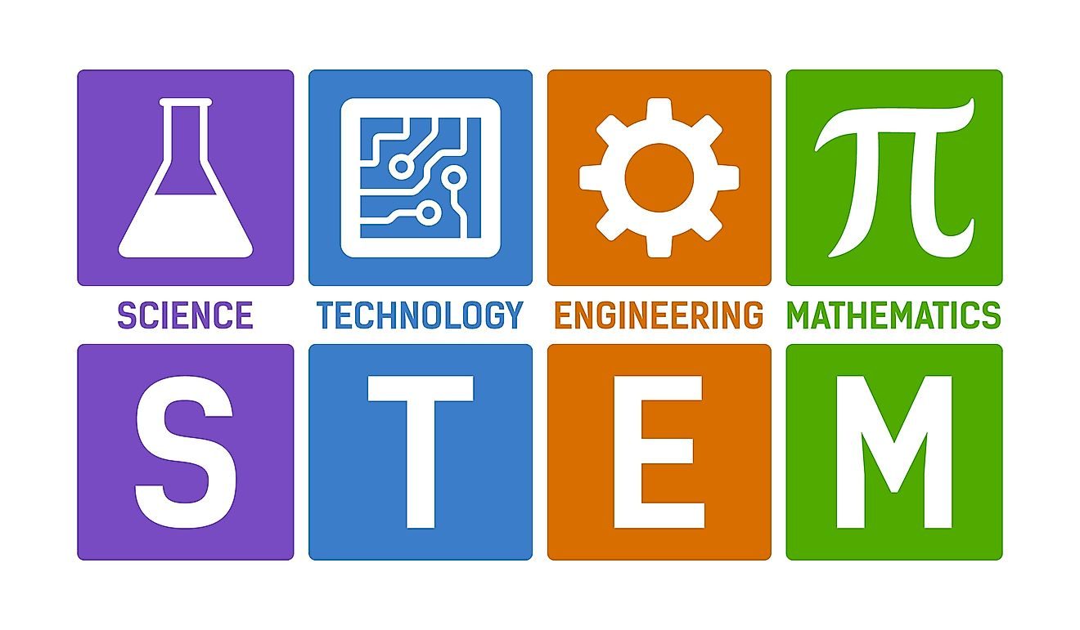
Career prospects of young STEM gratuates
Job Security
More resistant to economic downturns
Global Opportunities
The opportunity to work in different countries
Diverse Career Opportunities
Not limited to engineering
Innovation and Creativity
Working with new technologies

Slide 4

Pros and Cons of social science:
Pros:
Understanding Society
Social Impact
Diverse Opportunities
psychology, sociology, anthropology, economics, and political science
Cons:
Lower Earning Potential
Job Stability:

Slide 5

Pros and Cons of engineering:
Pros:
Problem Solving
High Demand
Innovation
Cons:
High Responsibility
Continuous Learning

Slide 6

Pros and Cons of education:
Pros:
Impactful Work
Job Satisfaction
Vacation Time
Cons:
Workload
Limited Earning Potential

Slide 7

Thanks for your attention

